Slide 1
Crystal Geometry and Structure Determination
Dr. Ranjit Kumar
Department of Chemical Engineering
Email: ranjit.kumar@snu.edu.in

Slide 2
Why study crystal structures?
When we look around much of what we see is non-crystalline (organic things like wood, paper, sand; concrete walls, etc. → some of the things may have some crystalline parts!).
But, many of the common ‘inorganic’ materials are ‘usually*’ crystalline: ◘ Metals: Cu, Zn, Fe, Cu-Zn alloys ◘ Semiconductors: Si, Ge, GaAs ◘ Ceramics: Alumina (Al₂O₃), Zirconia (Zr₂O₃), SiC, SrTiO₃.
Also, the usual form of crystalline materials (say a Cu wire or a piece of alumina) is polycrystalline and special care has to be taken to produce single crystals.
Polymeric materials are usually not ‘fully’ crystalline.
The crystal structure directly influences the properties of the material (as we have seen in the Introduction chapter many additional factors come in this regard, apart from the crystal structure).
Why study crystallography?
Gives a terse (concise) representation of a large assemblage of species
Gives the ‘first view’ towards understanding of the properties of the crystal
* Many of the materials which are usually crystalline can also be obtained in an amorphous form

Slide 3
Q & A
What properties/characteristics of the crystal arise from the definitions?
Crystals are endowed with the following characteristics. ➢ Crystals are periodic. ➢ Crystals are infinite theoretically. (However, practical crystals are finite!). ➢ Crystals have orientational and positional order. ➢ Many/most crystals have additional symmetries associated with them (we will see this soon).
Additionally: ➢ Crystals may be anisotropic with respect to many of the properties. ➢ Have well defined equilibrium shapes (at low temperatures), which reflect the internal symmetry present at the atomic level.

Slide 4

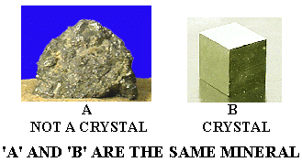
SOLID MATERIALS
CRYSTALLINE
Single Crystal
POLYCRYSTALLINE
AMORPHOUS
(Non-crystalline)

Slide 5
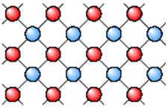
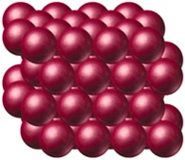
Crystal is a substance in which the atoms or molecules are arranged in a definite, repeating pattern in three dimensions.
Crystalline solid

Slide 6
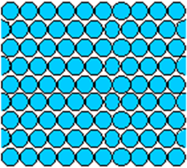
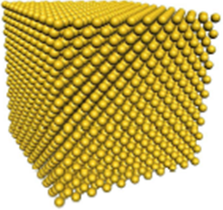
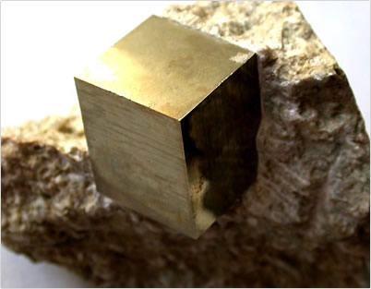
Single crystal has an atomic structure that repeats periodically across its whole volume. Even at infinite length scales, each atom is related to every other equivalent atom in the structure by translational symmetry.
Single Crystal
Single Pyrite
Crystal
Amorphous
Solid

Slide 7
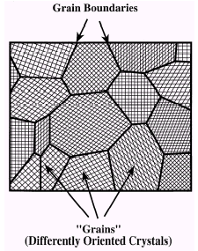
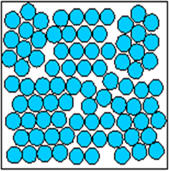
Polycrystal is a material made up of an aggregate of many small single crystals. (also called crystallites or grains)
The grains are usually 100 nm - 100 microns in diameter.
Polycrystals with grains that are < 10 nm in diameter are
called nano-crystalline
Polycrystal
Polycrystalline
Pyrite form
(Grain)

Slide 8
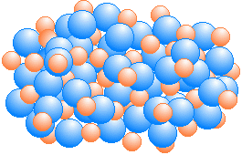
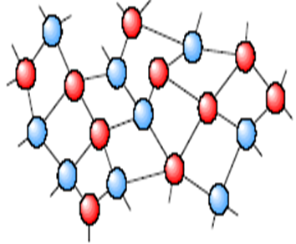
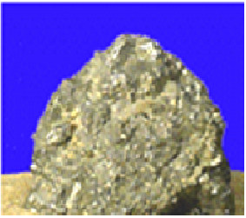
Amorphous (OR) isotropic solid is composed of randomly oriented atoms, ions (OR) molecules that do not form defined patterns (OR) lattice structures.

Slide 9
Crystal means…
A three dimensional translational periodic arrangement of atoms in space is called a crystal.
(OR)
The periodic array of atoms, ions, or molecules that form the solids is called Crystal Structure.

Slide 10
For better understanding of crystal structure, we must know the following technical terms of crystals like…..
Lattice
Space Lattice
Basis
Unit cell
Lattice parameters
Lattice constant
Atomic packing factor ( APF )
Co-ordination number…….

Slide 11
Space lattice
A three dimensional translational periodic arrangement of points in space is called a lattice.
(OR)
An infinite array of points in three dimensional in which every point has an identical environment to
all others is called space lattice.

Slide 12
Basis (or) Motif
An atom or a group of atoms associated
with each lattice point is called as basis
or motif.

Slide 13
What is the relation between
the lattice, basis & the crystal ?
Crystal = Space Lattice + Motif (basis)

Slide 14
+
=
Lattice
+
Basis
=
Crystal structure

Slide 15
Lattice
The underlying periodicity
of the crystal
How to repeat
Basis
Atom (OR) group of atoms associated with each lattice points
What to repeat

Slide 16
Facts about crystal cells
A cell is a finite representation of the infinite lattice.
A cell is a parallelogram (2D) or a parallelopiped (3D)
with lattice points at their corners.

Slide 17
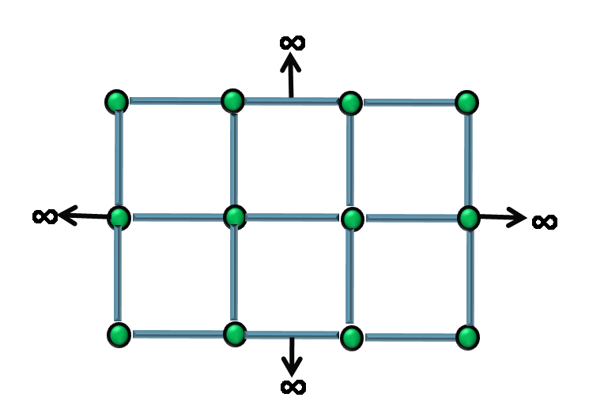
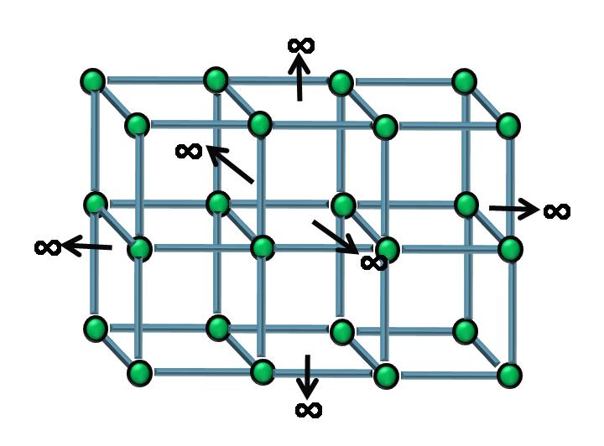
1-D Lattice
∞
∞
2-D Lattice
3-D Lattice
∞
∞
∞
∞
∞
∞
∞
∞
∞
∞

Slide 18
UNIT CELL
The smallest volume from which the entire crystal is build up by translational repetition in three dimensions, called as unit cell.
Y
i.e.
X
Z
It is the fundamental elementary pattern.

Slide 19
Primitive cell
If the lattice points are only at the corners, the cell is a primitive cell.
Example : Unit cell of a simple cubic structure.
Non-primitive cell
If there are lattice points in the cell other than the corners, the cell is non-primitive cell.

Slide 20
Lattice parameters
Y
The primitives( a,b,c) and the interfacial angles(α,β,γ) are called the lattice parameters.
b
Lattice parameters decide the actual size and shape of the unit cell.
α
γ
a
X
c
β
Z

Slide 21
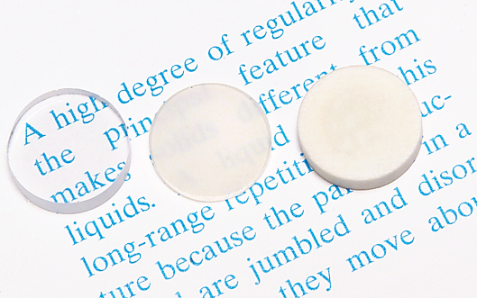
Crystallinity vs property
• Transmittance:
-- Aluminum oxide may be transparent, translucent, or
opaque depending on the material’s structure (i.e., single crystal vs. polycrystal, and degree of porosity).
polycrystal:
no porosity
polycrystal:
some porosity
single crystal

Slide 22
Relation between lattice constant(a)
And crystal density(ρ)
Volume of the unit cell = a³
Therefore, mass of the unit cell = volume x density
m = a³ρ -------------(1)
Let say ‘n’ molecules / unit cell , M is the molecular weight
and N is the Avogadro number.
Then mass of the each molecule = M/N
Mass of the each unit cell = n x M/N -----------(2)

Slide 23
Therefore, Eq.(1) = Eq.(2)
a³ρ = n x M/N
Lattice constant(a) = (nM/Nρ)^{1/3} ---------(3)
Eq.(3) gives the relation between lattice constant & crystal density.

Slide 24
Stacking sequence
A
B
C
The arrangement of atoms in the crystal.

Slide 25
Square packing
CONCLUSION: Not most space efficient

Slide 26
Hexagonal packing
CONCLUSION: Most space efficient

Slide 27
Unit Cells
The simplest repeating motif

Slide 28

BRAVAIS LATTICE
M. A. Bravais
Lattices are classified on the basis of their symmetry
In 1850, M. A. Bravais showed that identical points can be arranged spatially to produce 14 types of regular pattern. These 14 space lattices are known as ‘Bravais lattices’.

Slide 29
14 types of space lattices in the 7 systems of crystal,
which are called Bravais lattices.
Cubic 3
Tetragonal 2
Orthorhombic 4
Monoclinic 2
Triclinic 1
Rhombohedral 1
Hexagonal 1
07
14

Slide 30
Y
1. Cubic crystals(3)
Three lengths of the unit cell are same
and they are at right angles.
b
i.e. a = b = c
&
α = β = γ = 90⁰
γ
a
α
X
β
c
Ex: NaCl,Ag,Au,CaF,Pb,Cu,NaClo₂ etc
Z
Z
2. Tetragonal crystals(2)
c
Two lengths of the unit cell are equal
third one is longer and all are at right.
i.e. a = b ≠ c
&
α = β = γ = 90⁰
α
γ
a
X
β
Ex: Tio₂ , Sno₂ , KH₂Po₄
Y
b

Slide 31
Y
3. Orthorhombic crystals(4)
Lengths of the unit cell are different,
but they are at right angles.
b
i.e. a ≠ b ≠ c
&
α = β = γ = 90⁰
α
γ
a
X
β
Z
c
Ex: C₁₅H₂₀O₂, PbCo₃, BaSo₄, KNo₃, K₂So₄, α-S
4. Monoclinic crystals(2)
Lengths of the unit cell are different,
two axes are at right angles and
third one is obliquely inclined.
i.e. a ≠ b ≠ c
&
α = β = 90⁰ ≠ γ
Ex: CaSo₄ 2H₂0(Gypsum), K₂MgSo₄ .6H₂o

Slide 32


5. Triclinic crystal(1)
Lengths of the unit cell are different,
and they are obliquely inclined to
each other.
i.e. a ≠ b ≠ c
&
α ≠ β ≠ γ ≠ 90⁰
Ex: K₂Cr₂O₇, CuSo₄ 5H₂o
6. Rhombohedral(Trigonal)crystal(1)
Lengths of the unit cell are equal,
and axes are equally inclined to each
other at an angle other than 90⁰.
i.e. a = b = c
&
α = β = γ ≠ 90⁰
Ex: Calcite, As, Sb, Bi etc

Slide 33

7. Hexagonal crystal(1)
Two axes of the unit cell are equal in length
in one plane at 120⁰ with each other and
third axis is perpendicular to this plane.
i.e. a = b ≠ c
&
α = β = 90⁰ , γ = 120⁰
Ex: Quartz, Zn, Cd etc
CONCLUSION
Bravais lattices are explained on the basis of lattice parameters only.

Slide 34
Lattice Constant (a, b, c) | INTERFACIAL ANGLE (α,β,γ) | NAME OF THE CRYSTAL | No. OF LATTICES / TYPES | EXAMPLE
a = b = c | α = β = γ = 90⁰ | Cubic | 3 P,I,F | CsCl, NaCl
a = b ≠ c | α = β = γ = 90⁰ | Tetragonal | 2 P,I | TiO₂ (Rutile), SnO₂ (Cassiterite)
a ≠ b ≠ c | α = β = γ = 90⁰ | Orthorhombic | 4 P,I,F,C | KNO₃, BaSO₄ (Baryte)
a ≠ b ≠ c | α =γ = 90⁰ ; β ≠ 90⁰ | Monoclinic | 2 P,C | Monoclinic Sulphur, Na₂SO₄.10H₂O
a ≠ b ≠ c | α ≠ β ≠ γ ≠ 90⁰ | Triclinic | 1 P | CuSO₄.5H₂O
a = b ≠ c | α = β = 90⁰ ; γ= 120⁰ | Hexagonal | 1 P | Mg, Zn, PbI₂
a = b = c | α = β = γ <120⁰ ≠90⁰ | Rhombohedral (Trigonal) | 1 P | Ice, Al₂O₃
P: simple cubic (Primitive) I: body centered
F: face centered C: base centered

Slide 35
What are the symmetries of the 7 crystal systems?
Minimum symmetry of the 7 crystals systems are listed in the table below.
As an example: cubic crystals have four 3-fold axes (at least), while a trigonal crystal has only one 3-fold axis (but can have other symmetries). Tetragonal crystals have one 4-fold axis at least (but cannot have three 4-fold axes).
The characteristic symmetry refers to the minimum symmetry that needs to be present.
We have stated that basis of definition of crystals is ‘symmetry’ and hence the classification of crystals is also based on symmetry.
The essence of the required symmetry is listed in the table ➢ more symmetries may be part of the point group in an actual crystal.
(only translational symmetry)
Note: translational symmetry is always present in crystals (i.e. even in triclinic crystal)

Slide 36
Symmetry Elements
Element Symmetry Operation Symbol
Identity Identity E
n-fold axis Rotation by 2π/n C_{n}
Mirror plane Reflection σ
Center of inversion Inversion i
n-fold axis of Rotation by 2π/n S_{n}
improper rotation followed by reflection
perpendicular to the
axis of rotation

Slide 37
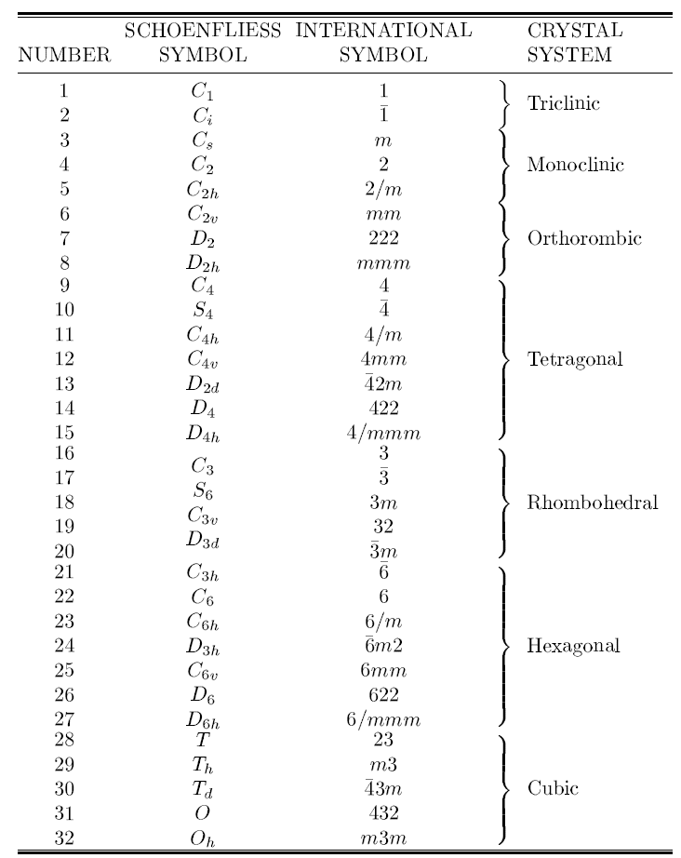

Slide 38

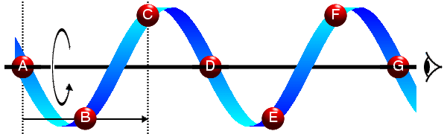
In crystallography, space groups are mathematical constructs that capture every way an object can be repeated through space, through translation, rotation, reflection, screws, and gliding. There are 230 space groups.
A glide plane reflection is the combination of a reflection across a line and a translation parallel to the line.
A screw axis is a line that is simultaneously the axis of rotation and the line along which translation of a body occurs. It is also known as a helical axis or twist axis.

